Slide 1
Topics
Iterators and ListIterators

Slide 2
Iterator Interface
Allows the traversing/iterating the elements of collections only in forward direction
All Collections use iterator interface and provides method for attaching iterator for any collection.
Iterator<E> iterator();
Methods :
boolean hasNext() → Returns true/false if there exists next element or not
E next() / Object next() → Returns the next element. Used in conjunction with hasNext()
void remove() → Removes the element from location pointed to by iterator

Slide 3
Iterator : Example 1
import java.util.*;
class IteratorTest
{
public static void main(String args[])
{
ArrayList<String> arrStr = new ArrayList<String>(20);
arrStr.add("A"); // A
arrStr.add("B"); // A B
arrStr.add("X"); // A B X
arrStr.add("Y"); // A B X Y
arrStr.add("Z"); // A B X Y Z
Iteraor<String> itr = arrStr.iterator();
while( itr.hasNext()
System.out.println(itr.next());
}// End of Method
}// End of class
Iterator Location in the Beginning
A B X Y Z
Next() Returns the Next Element
and forwards the Cursor Location

Slide 4
Iterator : Example 1 …
import java.util.*;
class IteratorTest
{
public static void main(String args[])
{
ArrayList<String> arrStr = new ArrayList<String>(20);
arrStr.add("A"); // A
arrStr.add("B"); // A B
arrStr.add("X"); // A B X
arrStr.add("Y"); // A B X Y
arrStr.add("Z"); // A B X Y Z
Iteraor<String> itr = arrStr.iterator(); while( itr.hasNext()
System.out.println( itr.next());
}// End of Method
}// End of class
Iterator Location Changes when next() Executes and the previous Element is Returned
A B X Y Z

Slide 5
Iterator : Example 1 …
import java.util.*;
class IteratorTest
{
public static void main(String args[])
{
ArrayList<String> arrStr = new ArrayList<String>(20);
arrStr.add("A"); // A
arrStr.add("B"); // A B
arrStr.add("X"); // A B X
arrStr.add("Y"); // A B X Y
arrStr.add("Z"); // A B X Y Z
Iteraor<String> itr = arrStr.iterator(); while( itr.hasNext()
System.out.println( itr.next());
}// End of Method
}// End of class
Iterator Location Changes when next() Executes and the previous Element is Returned
A B X Y Z

Slide 6
Iterator : Example 1 …
import java.util.*;
class IteratorTest
{
public static void main(String args[])
{
ArrayList<String> arrStr = new ArrayList<String>(20);
arrStr.add("A"); // A
arrStr.add("B"); // A B
arrStr.add("X"); // A B X
arrStr.add("Y"); // A B X Y
arrStr.add("Z"); // A B X Y Z
Iteraor<String> itr = arrStr.iterator(); while( itr.hasNext()
System.out.println( itr.next());
}// End of Method
}// End of class
A B X Y Z

Slide 7
Removing Elements Through remove() Method of Iterator
remove() → This method can be used to remove the element from a Collection
Rules
remove() method via Iterator interface instance can only be invoked only once per call to next() or previous()
add() method should not have been executed in between after the last call to next()/previous() and the remove() Method

Slide 8
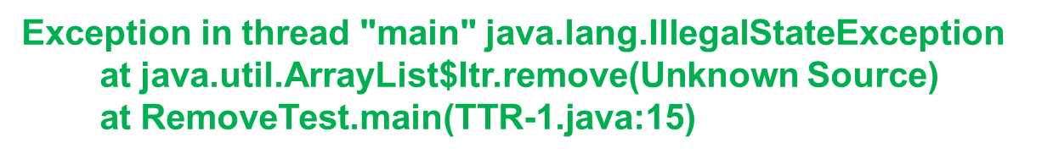
remove() Method of Iterator() : Example 1
// File Name : RemoveTest.java
import java.util.*;
class RemoveTest
{
public static void main(String args[])
{
ArrayList<String> nameList = new ArrayList<String>();
nameList.add("Java");
nameList.add("Object");
nameList.add("Fortran");
nameList.add("Pascal");
nameList.add("Python");
Iterator<String> itrnameList = nameList.iterator();
itrnameList.remove();
} // End of Method
}// End of class
remove() Method Can not be used Without a previous next() Method Call

Slide 9
remove() Method of Iterator() : Example 2
// File Name : RemoveTest.java
import java.util.*;
class RemoveTest
{
public static void main(String args[])
{
ArrayList<String> nameList = new ArrayList<String>();
nameList.add("Java");
nameList.add("Object");
nameList.add("Fortran");
Iterator<String> itrnameList = nameList.iterator();
System.out.println(nameList);
itrnameList.next();
itrnameList.remove();
System.out.println(nameList);
} // End of Method
}// End of class
OUTPUT
[Java, Object, Fortran]
[Object, Fortran]

Slide 10
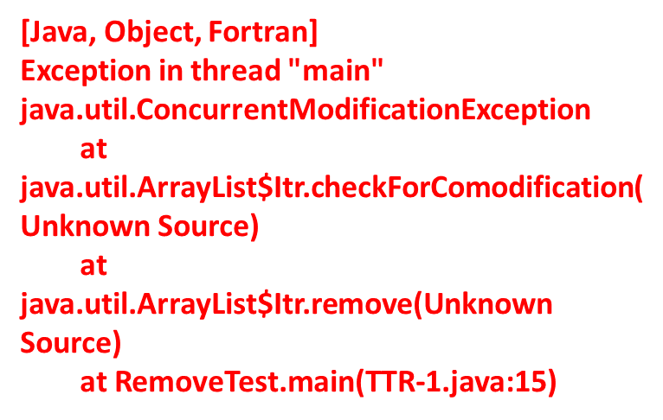
remove() Method of Iterator() : Example 3
// File Name : RemoveTest.java
import java.util.*;
class RemoveTest
{
public static void main(String args[])
{
ArrayList<String> nameList = new ArrayList<String>();
nameList.add("Java");
nameList.add("Object");
nameList.add("Fortran");
Iterator<String> itrnameList = nameList.iterator();
System.out.println(nameList);
itrnameList.next();
nameList.add(“Pascal”);
itrnameList.remove();
System.out.println(nameList);
} // End of Method
}// End of class
add() Method should not have been used in between the last calls to next() and the remove() Methods

Slide 11
ListIterator Interface
Allows Traversal in Both Ways [First to Last and Last to First] (Sub Interface of Iterator)
Every Collection of type List provides a method(s) for getting a suitable list iterators
Method(s) Provided by List interface for ListIterators
ListIterator listIterator() → Returns a ListIterator instance pointing at the beginning of the list
ListIterator listIterator(int index) → Returns a ListIterator instance pointing at ‘index’ location . The value of ‘index’ should be in range ‘0<=index<=S’ where ‘S’ is the size of the list.

Slide 12
ListIterator Interface : Syntax and Important Methods
Syntax
interface ListIterator<E> extends Iterator<E>
Important Methods
public void add(E e) → Inserts element ‘E’ in the list. The location is decided by the location where list iterator is pointing
public boolean hasNext() / hasPrevious() → Returns true if there exists the next or previous element otherwise false
public E next() / previous() → Returns the next or previous element and advances the cursor position forward/backward
public int nextIndex() / previousIndex() → Returns the index of the element returned by next() / previous()

Slide 13
ListIterator : Example 1
(Forward Traversal)
import java.util.*;
class IteratorTest
{
public static void main(String args[])
{
ArrayList<String> arrStr = new ArrayList<String>(20);
arrStr.add("A"); // A
arrStr.add("B"); // A B
arrStr.add("X"); // A B X
arrStr.add("Y"); // A B X Y
arrStr.add("Z"); // A B X Y Z
ListIteraor<String> itr = arrStr.listIterator(); while( itr.hasNext()
System.out.println( itr.next());
}// End of Method
}// End of class
ListIterator Location in the Beginning
A B X Y Z

Slide 14
ListIterator : Example 2
(Backward Traversal)
import java.util.*;
class IteratorTest
{
public static void main(String args[])
{
ArrayList<String> arrStr = new ArrayList<String>(20);
arrStr.add("A"); // A
arrStr.add("B"); // A B
arrStr.add("X"); // A B X
arrStr.add("Y"); // A B X Y
arrStr.add("Z"); // A B X Y Z
ListIteraor<String> itr = arrStr.listIterator(arrStr.size()); while( itr.hasPrevious()
System.out.println(itr.previous());
}// End of Method
}// End of class
ListIterator Location in the End
A B X Y Z

Slide 15
Thank You

